Slide 1
CS118 – Programming Fundamentals
Lecture # 23
Monday, November 18, 2019
FALL 2019
FAST – NUCES, Faisalabad Campus
Course Instructor:
Ebad Majeed
Slides Credit:
Rizwan Ul Haq

Slide 2
C-Strings (Character Arrays)
Character array: An array whose components are of type char
C-strings are null-terminated ('\0') character arrays
Example:
'A' is the character A
"A" is the C-string A
"A" represents two characters, 'A' and '\0‘

Slide 3
C-Strings (Character Arrays) (cont'd.)
Consider the statement
char name[16];
Since C-strings are null terminated and name has 16 components, the largest string that it can store has 15 characters
If you store a string of length, say 10 in name
The first 11 components of name are used and the last five are left unused

Slide 4
C-Strings (Character Arrays) (cont'd.)
The statement
char name[16] = {‘J’,’o’,’h’,’n’,’\0’) ;
Equivalent
char name[16] = “John” ;
declares an array name of length 16 and stores the C-string "John" in it
The statement
char name[] = “John” ;
declares an array name of length 5 and stores the C-string "John" in it

Slide 5
C-Strings (Character Arrays) (cont'd.)
Most rules that apply to other arrays also apply to character arrays. Consider the following statement:
char studentName[26] ;
Suppose you want to store "Lisa L.Johnson" in studentName
Because aggregate operations, such as assignment and comparison, are not allowed on arrays, the following statement is not legal:
studentName = "Lisa L. Johnson"; //illegal

Slide 6
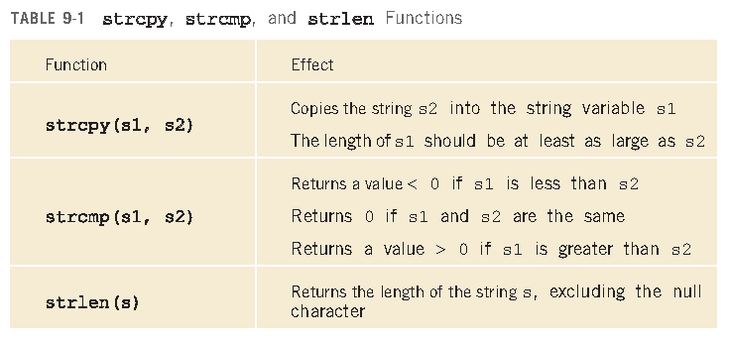
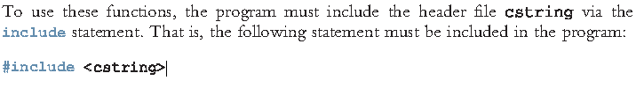
C-Strings (Character Arrays) (cont'd.)

Slide 7
String Comparison
C-strings are compared character by character using the collating sequence of the system
If we are using the ASCII character set
"Air" < "Boat"
"Air" < "An"
"Bill" < "Billy"
"Hello" < "hello"

Slide 8
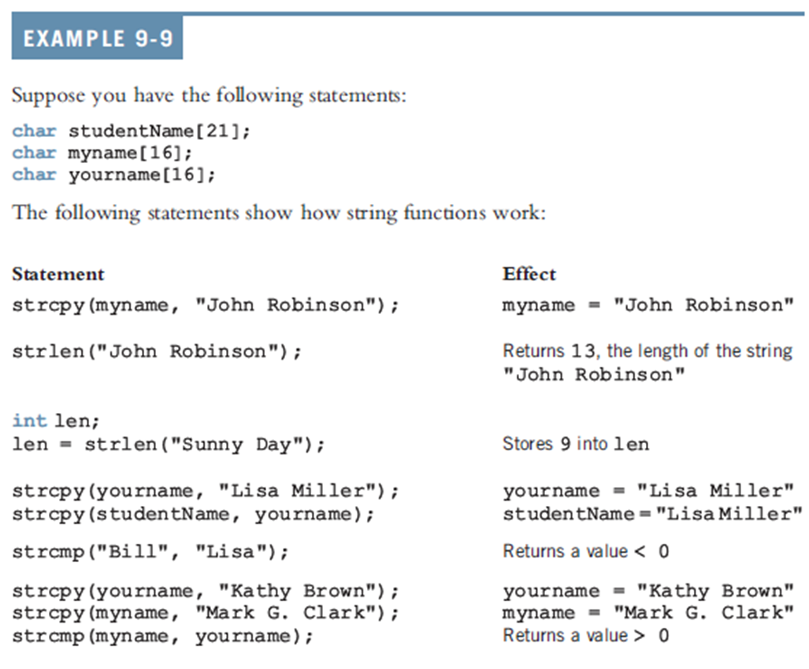
String Comparison (cont’d.)

Slide 9
Reading and Writing Strings
Most rules that apply to arrays apply to C-strings as well
Aggregate operations, such as assignment and comparison, are not allowed on arrays
Even the input/output of arrays is done component-wise
The one place where C++ allows aggregate operations on arrays is the input and output of C-strings (that is, character arrays)

Slide 10
String Input
cin >> name; stores the next input C-string into name
char name[31];
The length of the input C-string must be less than or equal to 30
stores the 30 characters that are input and the null character ‘\0’

Slide 11
String Input
Recall that the extraction operator, >>, skips all leading whitespace characters and stops reading data into the current variable
As soon as it finds the first whitespace character or invalid data
As a result, C-strings that contain blanks cannot be read using the extraction operator, >>
For example, if a first name and last name are separated by blanks, they cannot be read into name

Slide 12
String Input
To read strings with blanks, use get:
cin.get(str, m+1);
This statement stores the next m characters, or all characters until the newline character '\n' is found, into str.
Stores the next m characters into str but the newline character is not stored in str
If the input string has fewer than m characters, the reading stops at the newline character

Slide 13
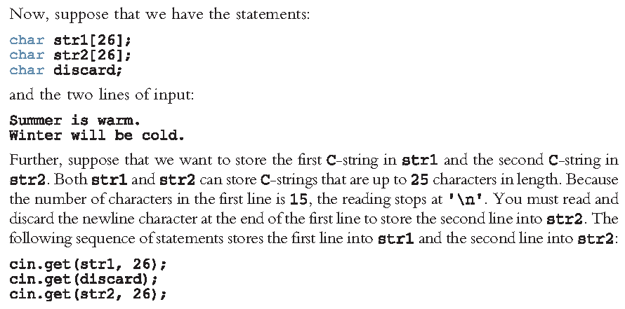
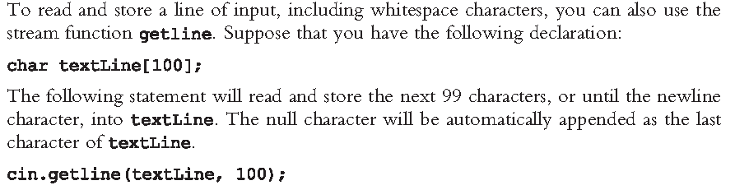
Example

Slide 14
String Output
Aggregate operations are allowed on string output as well
cout << name; outputs the content of name on the screen
<< continues to write the contents of name until it finds the null character
If name does not contain the null character, then we will see strange output
<< continues to output data from memory adjacent to name until '\0' is found

Slide 15
Questions

